Slide 1
THE LIBRARY CATALOGUE

Slide 2
Objectives
Students should be able to:
Appreciate the importance of the catalogue as a valuable bibliographic tool;
Identify a bibliographic record;
Search the KNUST OPAC with ease.

Slide 3
Introduction:
The library catalogue is an important tool for organization and retrieval of library resources.
Serves as a gateway to knowledge resources available to a library.
Presents an interface which provides links to the library’s resources.
A tool for finding useful resources to meet information needs.
Important for a user who wants to make maximal use of a library’s resources to learn what the catalogue offers and how it is used.

Slide 4
The Library Catalogue as a database
Bibliographic database- It is a database built from bibliographic record
Metadata ( acts as surrogate)-Gives information about the library material on the shelf
Can be manual or automated- Traditionally the catalogue record was produced on a card and filed in a cabinet. It served as a register of the library materials of a particular library. It had no links to other libraries’ resources.

Slide 5
The Library Catalogue as a database cont’d.
The situation is different now. Library catalogues are now linked and access to resources of other libraries can be gained through networking.
Resources that the catalogue can be used to locate include books, periodicals, audiovisual materials and others held by a library.

Slide 6
Terminologies
Cataloging record: A bibliographic record or the information traditionally shown on a catalogue card. The record includes a description of the item - main entry and added entries, publication details, physical description, subject headings, classification or call number, etc.
Main entry and added entries: They are the authorized access points for entries in the catalogue. AACR2 contains rules for determining access points to the record.
Access points: They are names, titles, terms, etc. used to identify/search bibliographic data.
Subject headings: They are the subjects under which the item is listed. Use of standard subject headings is important for consistency, to ensure that all items on a particular subject are found under the same heading and therefore in the same place in the catalog (eg. Which of these, salon or beauty palour, should be used as subject heading?)

Slide 7
Terminologies cont’d.
Call number: It is the mark – numeric or alphanumeric – that is used to identify an item in the library. (for example HB 171.5 sha ). The purpose of the call number is to place items on the same subject together on the same shelf in the library.
OPAC (Online Public Access Catalogue): Is an online database of materials held by a library or a group of libraries.

Slide 8
Terminologies cont’d.
Thus a cataloguing record should display the following:
Author (personal, corporate or conference name)
Title
Statement of responsibility
Edition statement
Imprint/Publication
Physical description /Series area
Notes/Annotation
Subject headings
Call number
Accession number

Slide 9
The KNUST OPAC can be accessed using the URL below:
libcat.knust.edu.gh

Slide 10
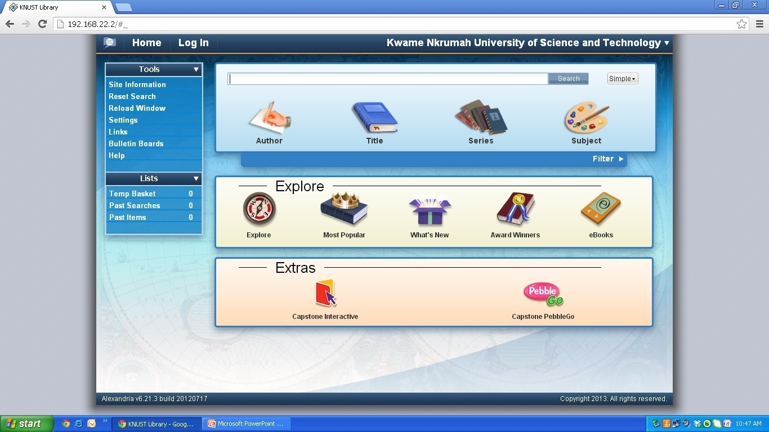
Researcher interface of the OPAC
Source: KNUST OPAC

Slide 11
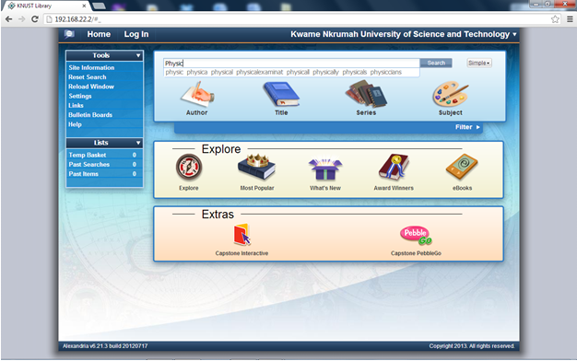
STEP 1 : ENTER AUTHOR OR TITLE OR SUBJECT

Slide 12
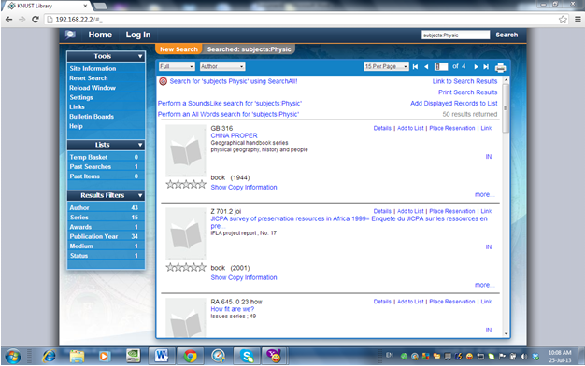
STEP 2: SEARCH RESULTS BASED ON SUBJECT

Slide 13
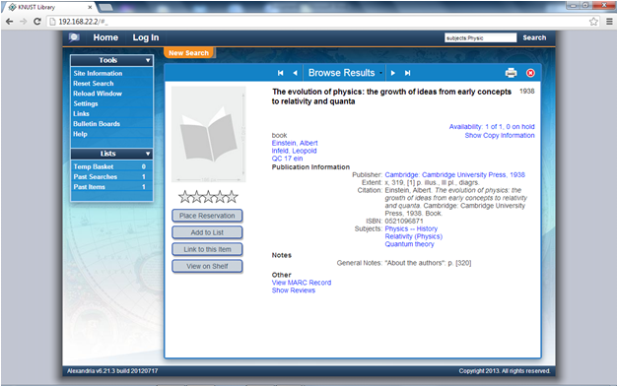
STEP 3: CLICK ON TITLE LINK

Slide 14
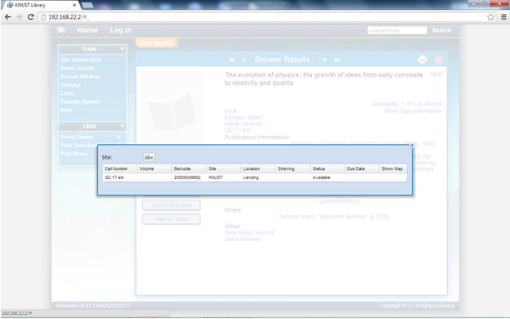
STEP 4: CLICK ON AVAILABILITY LINK TO GET SUMMARY

Slide 15
Note:
A well built catalogue makes it easy to find a resource or sets of resources :
belonging to the same work;
embodying the same expression;
exemplifying the same manifestation;
associated with a given person, family or corporate body;
on a given subject; and
defined by other criteria (language, place of publication, publication date, content type, etc) (IFLA, 2009).

Slide 16
Conclusion
The catalogue still remains an important tool for organization and retrieval of information in the electronic environment.
The traditional stand alone catalogue though, is making way for online public access catalogue.
In a networked environment the catalogue could be a valuable source of knowledge resources for the user of the library.

